Slide 1
Marketing Analytics – Final Report
EXECUTIVE SUMMARY
HYPOTHETICAL CLIENT: TOYOTA
DATA: Questionnaire and Excel file
RESEARCH OBJECTIVE:
Determine the qualities consumers look for in PLUG-IN hybrid electric vehicles (phevs), SEGMENT THE RESPONDENTS, IDENTIFY PSYCHOGRAPHIC INFLUENCES (SUCH AS MATERIALISM AND ENVIRONMENTALISM), advise on pricing, AND DELIVER A COHESIVE RECOMMENDATION FOR MARKETING A NEW PHEV MODEL.
Team B: jc, wg, mm, Jennifer mead, kt

Slide 2
Research Plan and Methodology
Questions | Data | Techniques
Who are our customers? Which customers should we target? | Section I Demographics, II Purchase Decisions, IV Attitudes Towards Climate Change | K-means clustering,
Why buy a car? | Section III Vehicle Acquisition | Descriptive statistics
Why buy a PHEV? What stops someone from buying a PHEV? | Section V Comfort with PHEV Technology | ANOVA, ANOVA with Multiple Comparisons
Which angle has the most resonance: status or the environment? Can a person care about both? | Section II Purchase Decisions, IV Attitudes Towards Climate Change | K-means clustering
What is the best price for a PHEV? | Section VI Future Vehicle Purchase | Descriptive statistics, Price Optimization
Summary: What overall recommendations do we have for features, pricing, customer segments, and positioning in the market for new Toyota plug-in hybrid/electric cars?
Note: we originally intended to use logistic regression, but the data didn’t support this approach.

Slide 3

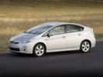






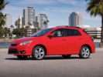
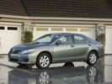



Business Context: Select 2011 Toyota Lineup
Sedans
SUVs
Pickup Trucks
Toyota Yaris: $13,155
Toyota Prius: $22,120
Toyota RAV4: $22,475
Toyota Tacoma: $16,365
Toyota Corolla: $15,900
Toyota Camry Hybrid: $27,050
Toyota Highlander: $28,090
Toyota Tundra: $24,435
Toyota Matrix: $18,845
Toyota Camry: $20,195
Toyota Highlander Hybrid: $38,140
Toyota Avalon: $33,195
Toyota Sequoia: $40,930
2011 hybrids in yellow

Slide 4
Data Findings: Who are our respondents?
Category | Cluster 1 | Cluster 2 | Cluster 3
Age | 26-35 | 26-35 | 26-35
Education | Bachelor’s degree | Some formal education, no degree | Some formal education, no degree
Gender | Female | Male | Male
Income | $75,000-100,000 | $25,000-$50,000 | $25,000-$50,000
Political Views | Democratic/ Independent | Democratic/ Independent | No clear political views
Home Ownership | Own home | Own home | Rent
Recycle | Sometimes/ Often | Sometimes/ Often | Sometimes/ Often
Early Adopters | First to own new technology | First to own new technology | Neutral
States respondents live in: Over 28% of survey participants live in states promoting PHEV autos. Other states that scored high such as Florida, North Carolina and Texas have favorable weather yearly
To do: compare to our customer base. How are respondents different?

Slide 5
Data Findings:
Decisions Related to Buying Vehicles
What factors influence vehicle purchase decisions (last vehicle/next vehicle)?
How long do you keep a vehicle?
90% keep a vehicle for > 4 years
Price and MPG are tops
What kind of vehicle do you drive?
How close is an outlet to where you park?
A quarter of respondents (26%) drive a compact vehicle
52% have an outlet within 25 feet

Slide 6
Data Findings: At what price should a PHEV be sold?
Nearly 76 % of all respondents wouldn’t spend an additional $1K-8K for saving an average of 50 gal of gas per month over each year of vehicle ownership.
Nearly 80 % of all respondents wouldn’t spend an additional $1K-4K for saving an average of 20 gal of gas per month over each year of vehicle ownership.
As the average of fuel-efficiency is reduced, the amount that customers are willing to pay over value is significantly reduced.
As the amount of fuel-efficiency decreased so did the dollar amount of the premium respondents were willing to pay.
Sedan: Toyota Prius: ($22,120*.76)+8,000 = $24,811
($22,120*.80)+4,000 = $21,696
($24,811+$21,696)/2= $23,254
SUV: Toyota RAV4: ($22,475 *.76)+8,000 = $25,081
($22,475 *.80)+4,000= $21,980
($25,081+$21,980)/2= $23,531
Pick-up: Toyota Tacoma: ($16,365*.76)+8,000= $20,437
($16,365*.80)+4,000 = $17,092
($20,437+$17,092)/2= $18,765

Slide 7
Conclusions:
At what price should a PHEV be sold?
A.) I would pay AT MOST additional to get a ZERO GHG-emissions vehicle, to help mitigate the worldwide ecological and financial impacts of global climate change in the hopes that it would directly benefit myself, loved ones, or our direct descendants, among others.
24 % of respondents would pay an additional $1K while 81% wouldn’t pay over $6K more.
B.) even if I didn’t think it would directly benefit myself, my children, or my immediate relatives.
34 % of respondents would pay an additional $1K while 87% wouldn’t pay over $6K more.
C.) even if I didn’t think it would directly benefit those in my local community.
37 % of respondents would pay an additional $1K while 89% wouldn’t pay over $6K more.
F.) even if I didn’t think it would directly benefit those in my country.
45 % of respondents would pay an additional $1K while 91% wouldn’t pay over $6K more.
Conclusion: it isn’t surprising that the respondents are motivated to spend more money on a car that benefits them personally. In order to justify the price increase of a PHEV, our marketing should emphasis benefits like saving money on gas rather than aiding their community or saving the environment.

Slide 8
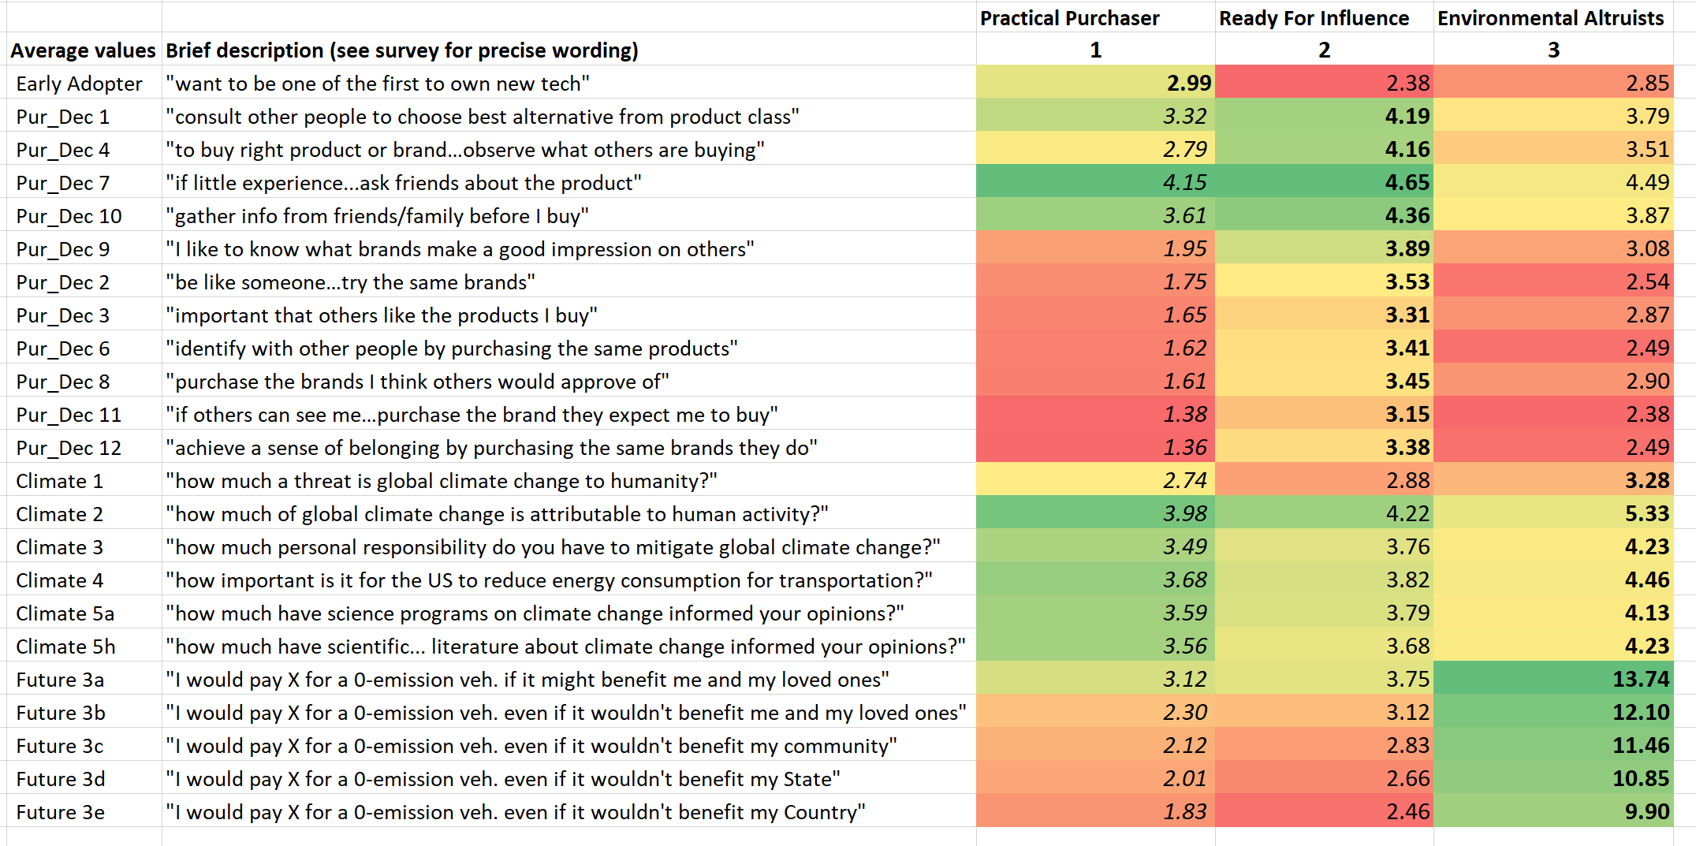
Data Findings: Environmentalism vs. Materialism
Looking for differentiation between purchasing decisions, we did k-means clustering on psychometric questions about environmental and materialistic values. We found three clear groups.
50% are Practical Purchasers
33% are Ready for Influence
The graphic at left shows the subset of questions with the clearest differentiation between groups.
Red values are the lowest in the column; green are the highest. Bold are the highest in the row; italics the lowest.
A larger sample size would be better. See the last slide for next steps, including repeating this study with customers.

Slide 9
Conclusions: Environmentalism vs. Materialism
Environmental Altruist | Practical Purchaser | Ready for Influence
What the data says
Highest scores on all questions about the environment Highest scores on questions about paying more for a vehicle even if it wouldn’t benefit them personally | Early adopter of new technology Lowest interest in personal materialism questions Care about researching purchases and getting information from others Acknowledge global climate change Lowest likelihood to pay more if it wouldn’t benefit them personally | Highest scores for practical materialism and for personal materialism questions Acknowledge global climate change Would pay more for PHEV if it benefitted them
How to reach them
This group wants to buy a PHEV regardless of marketing campaign and will pay far more than other groups Because they are out-numbered, focused advertising on just this group would not be cost-efficient Focus on getting customer testimonials from them on cost-savings and other benefits to use to convert other groups | Emphasize cool technology in PHEV Emphasize money-saving benefits of not paying for gas Use social media influencer campaign focusing on personal benefits of a PHEV | This group will follow the other two. They will seek the approval and information from both the Practical Purchasers and the Environmental Altruists, so focus marketing on the other groups first then use them to convert the Ready for Influence group.

Slide 10
Data Findings: What factors influence PHEV buying decisions?
To determine the factors or relationships that influence a car owner’s consideration of purchasing a PHEV, we compared responses using One-Way ANOVA with Post-Hoc Multiple Comparisons.
There is a statistically significant difference between… | And…
The possibility of purchasing a PHEV compact vehicle | the type of vehicle people already own – specifically those who already own a compact vehicle.
Being aware of the difficulties to repair a PHEV | how long one typically owns a vehicle (1-3 or 7-9 years).
The lifetime of the battery | the price of the vehicle.
Tax rebate upon purchase | the importance of power/performance.
Type of vehicle | being able to recharge at home as well as knowing the PHEV can run on gasoline when the battery dies.
Fuel efficiency | knowing PHEV can run on gasoline when the battery dies, battery can be recharged at home, and the PHEV is offered as a compact vehicle.

Slide 11
Conclusions: What factors influence PHEV buying decisions?
Respondents are inclined to consider purchasing a compact PHEV if they:
already own a vehicle of the class that is being sold as a PHEV (ex: a compact vehicle)
know the PHEV can run on gas when needed
don’t have to worry about battery failure
don’t have to worry about repairs
can recharge at home
receive rebates

Slide 12
Recommendations for Next Steps
Psychographic segments: Do a phased marketing campaign that uses customer feedback from early adopters to influence later adopters.
Justify price: In order to justify the increased cost of the PHEV, emphasize the savings on gas and the tax rebate.
Emphasize reliability: Ease of repairs, warranty of the battery, and the fact that PHEV runs on gas when necessary are all selling points.
Compact cars: Target current Toyota customers who own compact cars and competitors’ customers who own similar cars (ex: Honda Civic, Ford Focus).
Powerful promotion: For early adopters, run a promotion with a coupon to Angie’s List (or similar) for an electrician to install an outlet in the customer’s garage, driveway, or parking space so that they can charge their car.
Customers vs respondents: Repeat the questionnaire with a group of current customers and look-alikes to compare their responses to the internet sample. Is the sample skewed?
Focus groups: Run focus groups in a mix of northern and southern US cities with a representative sample of the Toyota demographic and look-alike non-customers to get feedback on the marketing campaign before running a pilot.

Slide 13
References
University of Vermont. (2014). Investigating consumer choice behavior through online experiments [Data file and survey form]. Retrieved from http://www.cs.uvm.edu/~meppstei/PHEVsurvey/
Claritas, Inc. “Claritas PRIZM.” CLARITAS MyBestSegments, Claritas, LLC, 2018, segmentationsolutions.nielsen.com/mybestsegments/Default.jsp.
2011 Toyota Cars. (2018, June 16). Retrieved from https://www.autobytel.com/toyota/2011

